Slide 1

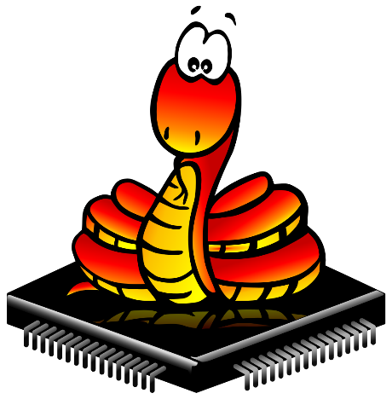
MicroPython
para aplicaciones IoT
Eduardo Pivaral
- Febrero 2021 -
Notes:
To use this title animation slide with a new image simply 1) move the top semi-transparent shape to the side, 2) delete placeholder image, 3) click on the picture icon to add a new picture, 4) Move semi-transparent shape back to original position, 5) Update text on slide.

Slide 2
“En 2020, por primera vez, hay más conexiones de IoT que conexiones que no lo son.
De todos los dispositivos activos en el mundo, 54% fueron dispositivos IoT a finales de 2020.
Para 2025, se espera que haya más de 30 mil millones de conexiones IoT.
Casi 4 dispositivos por persona.”
https://iot-analytics.com/state-of-the-iot-2020-12-billion-iot-connections-surpassing-non-iot-for-the-first-time/

Slide 3




Eduardo Pivaral
Experience
+15 Years of experience working on IT
+10 Years of experience working with SQL Server
Developer of Open-Source tools for SQL Server administration, development and productivity.
SQL Server Database Consultant Pythian
www.studyyourdata.com
Certifications
Azure Database Administrator Associate
Azure Fundamentals
MCSE Data Management and Analytics
MCSA SQL 2016 Database Development
MCSA SQL 2016 Database Administration
MCSA SQL 2012/2014
*Entusiasta de la electrónica e integración de sistemas
Eduardo Pivaral
Community
Regular Author for MSSQLTips.com
Regular Author for SQLServerCentral.com
MSSQLTips.com Rookie of the year 2018
Board member of Guatemala SQL Server User Group
Owner of StudyYourdata.com
@EduardoDBA
Epivaral

Slide 4

IoT
Acrónimo para Internet of Things (Internet de las cosas)
“¿Que es?”
Dispositivos electrónicos con acceso a internet para aplicaciones embebidas de monitoreo y control
“¿Como?”
Todo puede estar conectado a internet y ser controlado remotamente
“¿Para?”
Nuevas posibilidades para integración de sistemas
Mas info aquí: https://github.com/Epivaral/Sessions/tree/master/IoThub

Slide 5


MicroPython
cmath – mathematical functions for complex numbers
gc – control the garbage collector
math – mathematical functions
uarray – arrays of numeric data
uasyncio — asynchronous I/O scheduler
ubinascii – binary/ASCII conversions
ucollections – collection and container types
uerrno – system error codes
uhashlib – hashing algorithms
uheapq – heap queue algorithm
uio – input/output streams
ujson – JSON encoding and decoding
uos – basic “operating system” services
ure – simple regular expressions
uselect – wait for events on a set of streams
usocket – socket module
ussl – SSL/TLS module
ustruct – pack and unpack primitive data types
usys – system specific functions
utime – time related functions
uzlib – zlib decompression
_thread – multithreading support
Python 3
https://micropython.org/
MicroPython
Implementación de Python 3 optimizado para ejecutarse en microcontroladores
btree – simple BTree database
framebuf — frame buffer manipulation
machine — functions related to the hardware
micropython – access and control MicroPython internals
network — network configuration
ubluetooth — low-level Bluetooth
ucryptolib – cryptographic ciphers
uctypes – access binary data in a structured way
Open source: https://github.com/micropython

Slide 6
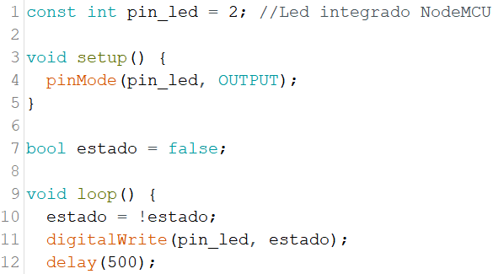
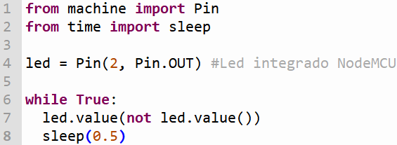
Micropython
Diferencias con C++
C++
MicroPython
Lenguaje compilado
Código mas compacto y eficiente
Strong typed
Codigo estático
Memory allocation
Lenguaje Interpretado
Mayor facilidad de uso y escalabilidad
Dynamic typed
REPL y WiFi REPL
Garbage collector

Slide 7
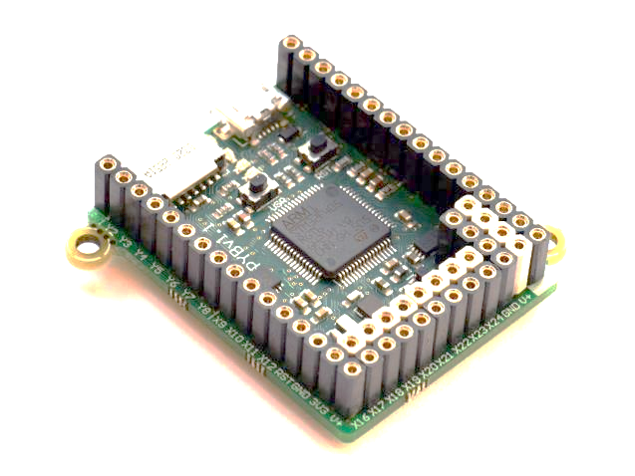
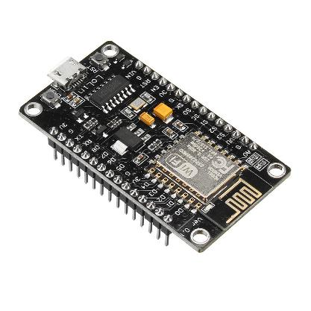
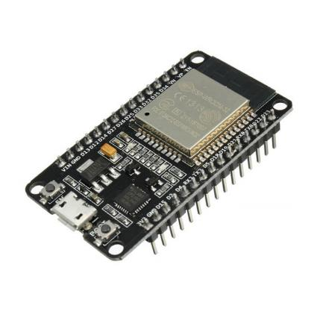
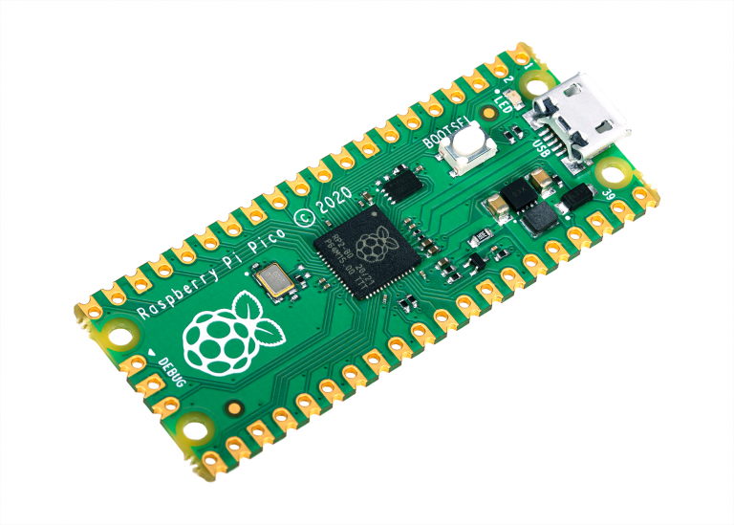
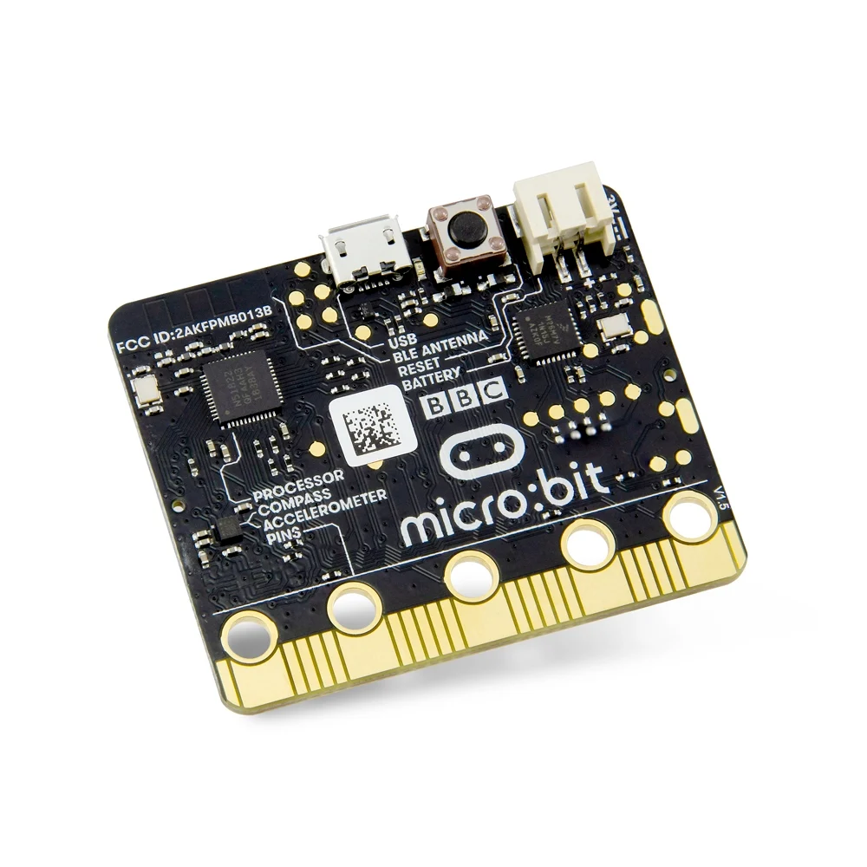
MicroPython
ESP8266
PyBoard
Microcontroladores
Rpi Pico
ESP32
Listado Completo:
https://forum.micropython.org/viewforum.php?f=10
Micro:bit

Slide 8
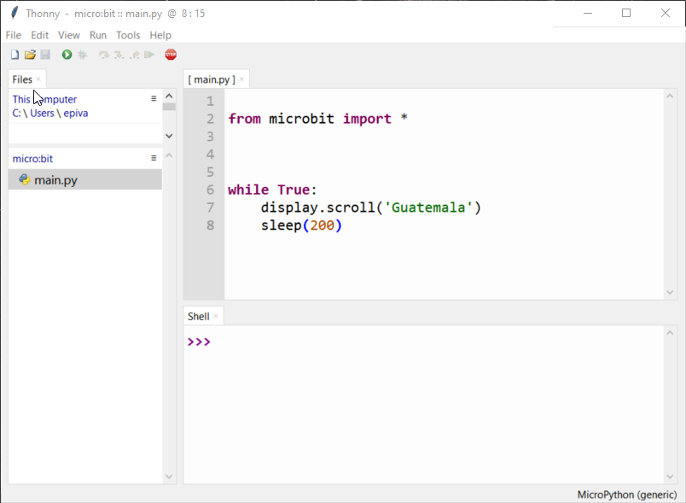

MicroPython
IDE
Thonny
https://thonny.org/

Slide 9
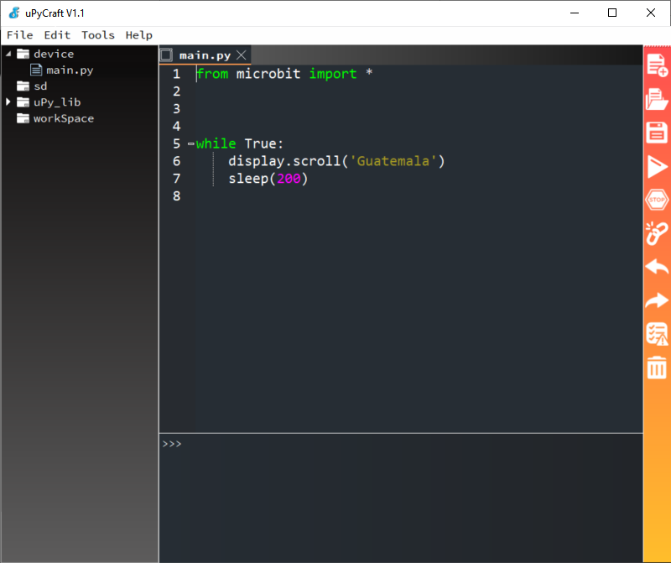
MicroPython
IDE
uPyCraft
https://dfrobot.gitbooks.io/upycraft/content/

Slide 10
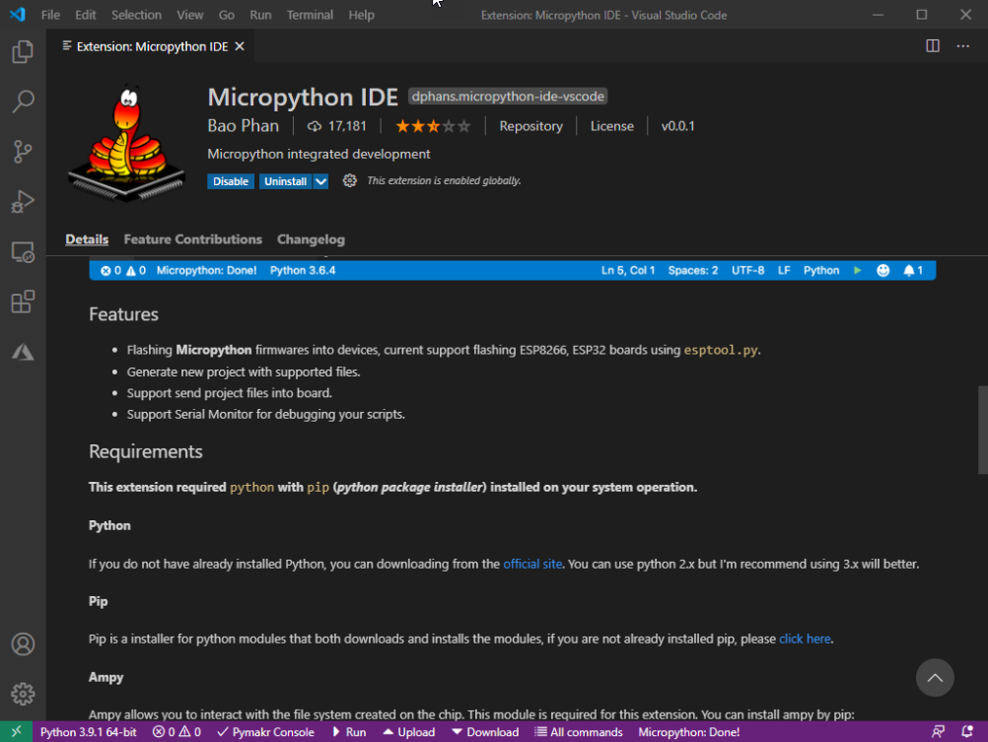
MicroPython
IDE
VSCode
*solo Mac y Linux
https://code.visualstudio.com/
Luego: extensión Micropython IDE

Slide 11
MicroPython
Homepage:
https://micropython.org/
Repositorio GitHub:
https://github.com/micropython
Wiki:
http://wiki.micropython.org/Home
Documentación:
http://docs.micropython.org
Librerías incluidas:
http://docs.micropython.org/en/latest/library/index.html
Referencias útiles

Slide 12
OK, entonces ¿que necesito para comenzar?
1
2
3
4
5
Python 3
https://www.studyyourdata.com/2021/01/install-python-on-windows.html
IDE de tu preferencia
uPyCraft
Thonny
VSCode
Un board compatible
Flash tool esptool.py
*solo ESP8266/ESP32
http://micropython.org/download/esp8266/
http://micropython.org/download/esp32/
Empieza tu proyecto!
main.py

Slide 13
Demos

Slide 14

Muchas gracias!
epivaral@studyyourdata.com
www.studyyourdata.com
Eduardo Pivaral
@EduardoDBA
Material disponible en: https://github.com/Epivaral/Sessions
Epivaral

